Slide 1

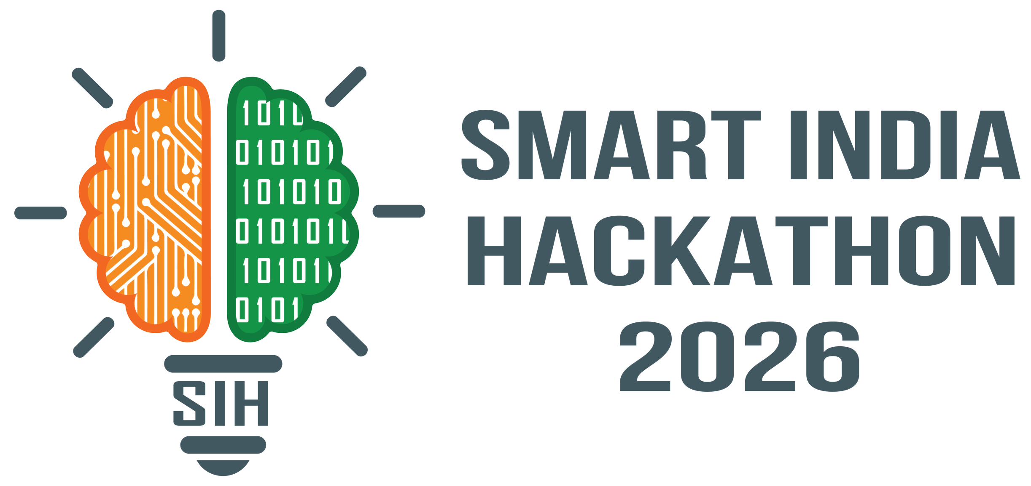
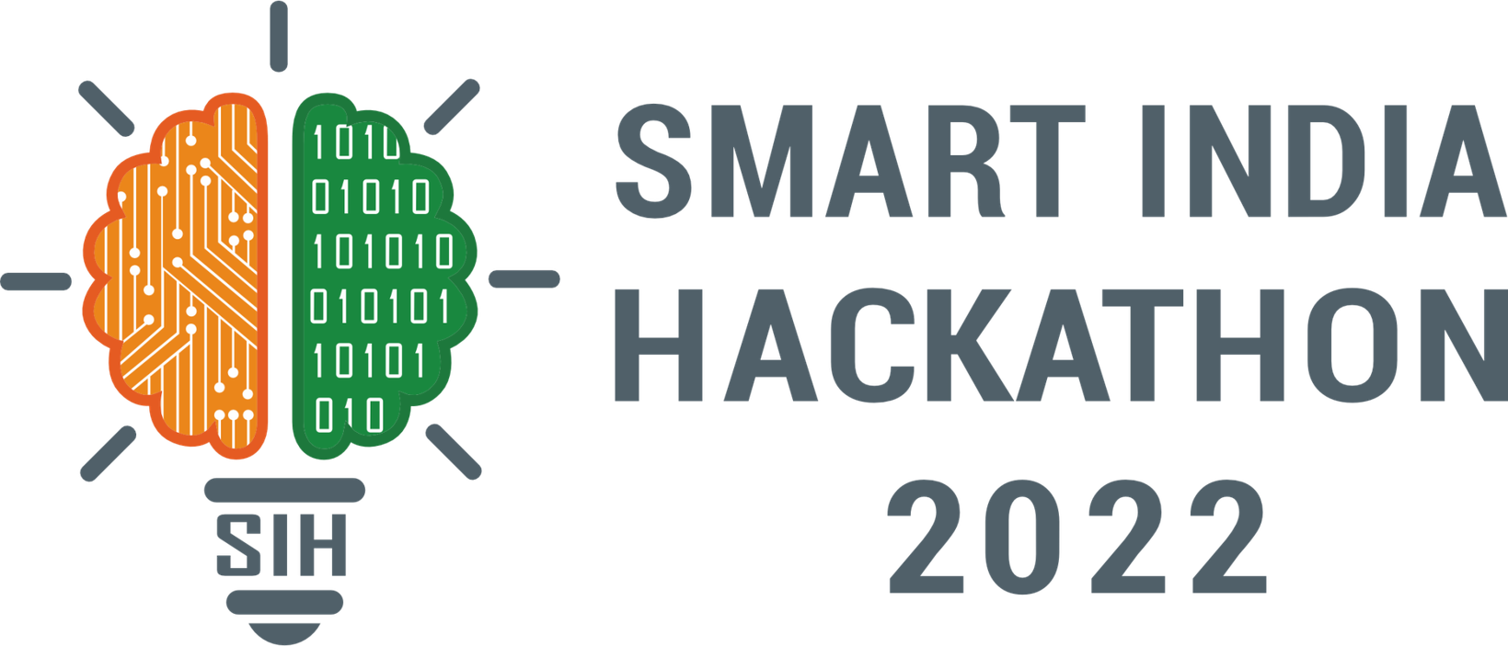
SMART INDIA HACKATHON 2026
Problem Statement ID – SIH26045
Problem Statement Title- IP-SAKTI sahayak a multilingual , RAG-Based (source cited) AI assistant
Theme- MedTech/ BioTech/ HealthTech
PS Category- Software
Team ID-
Team Name: Hallucinators

Slide 2


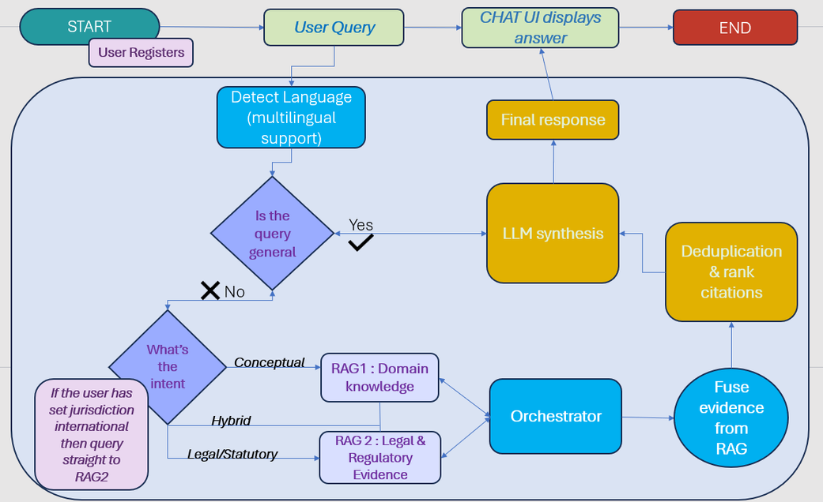
IP SAKTI SAHAYAK
HALLUCINATORS
Where Traditional Knowledge Meets Its Rightful Protection
Proposed Solution / Approach
IP SAKTI END TO END WORKFLOW
A multilingual AI assistant that answers Ayurveda IP and regulatory questions using real statutes, treaties, and registry records — not a general-purpose chatbot guessing at law.
It first figures out what kind of question is being asked (a concept, a binding legal/statutory question, or both) so it always pulls from the right expertise before answering using its RAG based modeling
National (India) and international laws are kept strictly separate through a jurisdiction toggle, so a user never gets conflated or wrong-country guidance.
Every answer is traceable to its source means a specific act, rule, or treaty article will be cited instead of an unverifiable AI summary.
Built to grow in stages: a working retrieval-based prototype already runs end-to-end; next stages add a knowledge graph, human-expert escalation, and full multilingual/voice delivery.
SMART INDIA HACKATHON 2026
2

Slide 3










TECHNICAL APPROACH
HALLUCINATORS
Implementation Process
Zone 1
Zone 2
Zone 3
Zone 4
Users and external services
Frontend
(Presentation layer)
Backend
(Application layer)
Data & Intelligence Layer
Query Submission
Third-party services
User asks a question via the multilingual chat interface
Groq LLM
API
TKDL /IP
india registries
IP-SAKTI Sahayak App
(React + Vite)
Backend server
(Fast API ,Python)
BHASHINI
Reasearch assistant
(multilingual chat interface)
API Gateway
(FastAPI router + CORS)
AI/ML Retrieval & Synthesis Engine
Intent & Language Detection Router classifies the query as conceptual, legal, or hybride.
ABS
RECORDS
Tech: Python, scikit-learn, SQLite, Groq LLM
Orchestrator Service
(Receives query, manages flow)
vector.db / vector_rag2.db
SQLite-backed chunk + vector storage for RAG 1 and RAG 2 respectively
Jurisdiction Toggle
(switch between India and international legal context)
Query Router
(Intent detection : conceptual/hybrid/legal
Dual RAG Retrieval
Domain knowledge (RAG 1) and/or legal evidence (RAG 2) searched in parallel
RAG 1 Service
(domain knowledge retrieval)
Citation Ranking Engine
deduplicates evidence, sorts by authority tier
DATABASE
interacts with
personalised
dashboard
Explore tools
(IP classification , access and benefits sharing helper)
Evidence Fusion & Ranking
RAG 2 Service
(legal & regulatory retrieval logic, versioning + conflict detection
LLM Synthesis (Groq)
(generates the final structured, citation-bound answer)
Results deduplicated and sorted with statutory sources first
Workspace and history
(saved chat sessions, quick start guided prompts)
RAG Registry
(dynamically connects additional RAG microservices at runtime)
Guardrailed Synthesis
Groq LLM drafts a structured answer, barred from inventing citations
Cited Response & Escalation
Final answer + disclaimer delivered; low-confidence cases can route to a human IP facilitator
Components / Technology stack to be used
SMART INDIA HACKATHON 2026
3

Slide 4

FEASIBILITY AND VIABILITY
HALLUCINATORS
Feasibility
Viability
Practical Implementation
A staged rollout (MVP → knowledge graph & agentic reasoning → paid-source connectors → full multilingual/voice) keeps cost and complexity manageable at each phase, rather than requiring the full vision upfront.
Human-facilitator escalation on low-confidence queries builds trust incrementally , adoption doesn't depend on the AI being perfect from day one.
A working RAG-based prototype already retrieves and synthesizes cited answers end-to-end
Built on lightweight, proven tech (FastAPI, scikit-learn, hybrid BM25 + vector search) ,no GPU or heavy infra dependency for the core retrieval engine.
The formulation-classification and jurisdiction-toggle logic maps directly onto existing free public sources (TKDL, India Code, IP India, NBA)
Already deployable as a lightweight web app; ready for an institutional pilot (AIIA, AYUSH startups/MSMEs) without major re-architecture.
Runs on modest infrastructure (SQLite-backed retrieval, no specialized hardware) low barrier to hosting even for a government/institutional deployment.
Multilingual delivery via Bhashini is a defined next milestone in the roadmap, not a ground-up redesign
Corpus currency — keeping a version-tracked corpus of statutes, treaties, and registry records up to date as law changes is ongoing effort
Maintain a version-tracked, human-curated corpus pipeline with scheduled legal-update reviews
01
01
02
Hallucination risk:any LLM-generated legal-adjacent content carries risk if guardrails fail or retrieved evidence is thin
Enforce citation-grounded synthesis with explicit no-fabrication guardrails and confidence-based abstention
02
03
Paid-source access: integrating subscription-based registries requires secure handling of user credentials and explicit consent
Access paid sources only with explicit, logged user permission; default to free official databases otherwise
03
Potential Challenges and Risks
Strategies For Overcoming Challenges
Trust & adoption AYUSH practitioners and MSMEs may be cautious about relying on AI for IP-sensitive decisions
Position the tool as an assistant, not an authority standing "information, not legal advice" disclaimer plus human-facilitator escalation
04
04
05
Multilingual legal accuracy:extending beyond English while preserving legal terminology is technically difficult
Roll out multilingual support incrementally via Bhashini, validating legal-term accuracy per language before wider release
05
SMART INDIA HACKATHON 2026
4

Slide 5


IMPACT AND BENEFITS
HALLUCINATORS
Ayurvedic Vaidyas & Traditional Healers:
Multilingual Legal Accessibility: Translates complex statutory requirements into regional languages, enabling grassroots healers and small practitioners to protect ancestral knowledge without prohibitive legal expenses.
Benefits of the solution
Built-in jurisdictional separation prevents cross-country legal conflation, providing verifiable, audit-proof statutory citations (Patents Act, Biodiversity Act, Nagoya Protocol, WIPO Treaties).
Ministry of Ayush &
Regulators:
Tracks emerging IPR filings, monitors compliance with Biodiversity Acts, and prevents unlawful monopolization of classical formulations.
IP Attorneys & Patent Examiners (IPO/WIPO):
Provides pinpoint citations to specific sections, rules, and gazettes, streamlining novelty checks under Section 3(p) and international patent standards.
01
Legal
Cuts patent drafting and prior-art search costs by up to 70% for MSMEs, encouraging commercialization of novel herbal formulations and increasing global market share.
Potential Impact on Targeted Audience
Economic
Nation & Indigenous Communities:
Secures India's bio-heritage against global biopiracy while fostering an innovation ecosystem for authentic Ayurvedic exports.
AYUSH Researchers & Startups:
Delivers instant patentability and prior-art assessments against TKDL and international databases, slashing regulatory clearance timelines from months to days.
Preserves codified traditional knowledge and prevents unauthorized biopiracy abroad through proactive TKDL alignment and automated patent surveillance.
Cultural
Democratizing Ayurveda IPR: Protecting ancestral heritage, preventing biopiracy, and accelerating commercialization through verifiable AI.
SMART INDIA HACKATHON 2026
5

Slide 6
RESEARCH AND REFERENCES
HALLUCINATORS
Field & Applied Research
Practitioner & Legal Field Analysis: Consulted Ayurvedic practitioners, IP attorneys, and regulatory specialists to map friction points in patent filings under Indian Patents Act Sec 3(p) (TK bar), Sec 3(e) (synergy bar), and NBA approval workflows.
Multi-RAG Evidence Indexing: Built and vector-indexed a curated corpus of 2,500+ statutory legal chunks alongside TKDL (Traditional Knowledge Digital Library) classifications, classical Samhita formulations (Charaka, Sushruta, Vagbhata), and botanical prior-art datasets.
Academic & Government Sources
The Patents Act, 1970 & Patent Rules (India Code): Official statutory provisions governing patentability standards (Sec 3(p), 3(e), 3(d)) and Section 10(4) mandatory biological source disclosures. https://www.indiacode.nic.in/handle/123456789/1392
The Biological Diversity Act, 2002 & NBA Guidelines (National Biodiversity Authority): Statutory mandate for Form III approvals, Access & Benefit Sharing (ABS), and Nagoya Protocol compliance for IPR applicants. http://nbaindia.org/content/25/19/1/act.html
Traditional Knowledge Digital Library (TKDL) & CSIR Prior-Art Corpus: Standardized Sanskrit taxonomy, classical formulation references, and international patent examiner protection guidelines. https://www.tkdl.res.in/tkdl/langdefault/common/Home.asp
Drugs & Cosmetics Act, 1940 & AYUSH Licensing Rules: Statutory standards for Form 25D ASU drug licensing, Rule 158B safety/clinical waivers, and FSSAI (Ayurveda Aahara) Regulations 2022. https://ayush.gov.in/
WIPO Treaty on IP, Genetic Resources & Associated Traditional Knowledge (2024): International legal treaty governing mandatory disclosure obligations of genetic origin and traditional knowledge in patent applications.
https://www.wipo.int/en/web/traditional-knowledge
SMART INDIA HACKATHON 2026
6

